Slide 1
SECURED LOGIN WITH SQL INJECTION
GUIDE
Prof. S. S. Jadhav
PRESENTED BY
Sarthak Nilesh Thorat
Suraj Nandlal Shirude
Hitesh Pankaj Saswadkar
Pratik Rajendra Karhekar
Vishal Dadasaheb Tanawade
1

Slide 2
INTRODUCTION
SQL Injection and Cross-site Scripting (XSS) attacks are most powerful in todays web application. Hence, the big challenge became to secure such a website against attack via the Internet.
The issue of SQL Injection Attack still exists and has become a giant online threat to many companies who became a victim of SQL Injection Attack vulnerability and cost them a lot of money.
2

Slide 3
INTRODUCTION
SQL injection, is a common attack vector that uses malicious SQL code for backend database manipulation to access information that was not intended to be displayed.
3

Slide 4
PROBLEM STATEMENT
To create a secured login via PHP and SQL and prevents SQL Injection of any level
4

Slide 5
Software & Hardware Requirement
Windows 7 and above version.
XAMPP
Hard disk: 10GB
RAM: 512 MB
5

Slide 6
XAMPP
XAMPP is a free and open-source cross-platform web server solution stack package developed by Apache Friends.
Consisting mainly of the Apache HTTP Server, MariaDB database, and interpreters for scripts written in the PHP and Perl programming languages.
6

Slide 7
PHP
PHP is a server scripting language, and a powerful tool for making dynamic and interactive Web pages.
PHP is a widely-used, free, and efficient alternative to competitors such as Microsoft's ASP.
7

Slide 8
METHODOLOGY
Primary Defenses:
Option 1: Use of Prepared Statements (with Parameterized Queries)
Option 2: Use of Properly Constructed Stored Procedures
Option 3: Allow-list Input Validation
Option 4: Escaping All User Supplied Input
Additional Defenses:
Also: Enforcing Least Privilege
Also: Performing Allow-list Input Validation as a Secondary Defense
8

Slide 9
SQL Injection
SQL injection, also known as insertion, is a malicious technique that exploits vulnerabilities in a target website’s SQL-based application software by injecting malicious SQL statements or by exploiting incorrect input.
SQL injection is one of the most common web hacking techniques.
9

Slide 10
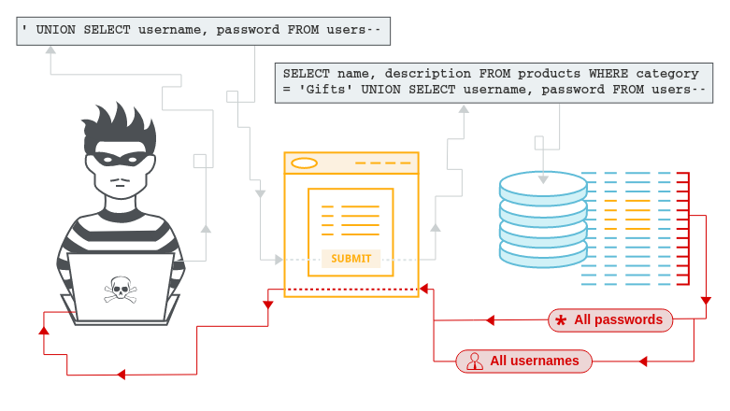
SQL Injection
A web security vulnerability that allows an attacker to interfere with the queries that an application makes to its database

Slide 11
SQL Injection
SQL injection usually occurs when you ask a user for input, like their username/user id, and instead of a name/id, the user gives you an SQL statement that you will unknowingly run on your database.
SQL injection is the placement of malicious code in SQL statements, via web page input.
11

Slide 12
Implementation and Evaluation:
We have developed a proxy which helps in detection and avoiding SQL injection and cross site scripting attack.
A website that is purposefully vulnerable to SQL injection attacks is developed. The login page is vulnerable to SQL injection making it easy to bypass login. T
he system then detects the SQL Injection and we can prevent that login using below function:
mysqli_real_escape_string()
12

Slide 13
mysqli_real_escape_string()
It special characters in a string for use in an SQL statement, taking into account the current charset of the connection
Parameter | Description
connection | Required. Specifies the MySQL connection to use
escapestring | Required. The string to be escaped. Characters encoded are NUL (ASCII 0), \n, \r, \, ', ", and Control-Z.
13

Slide 14
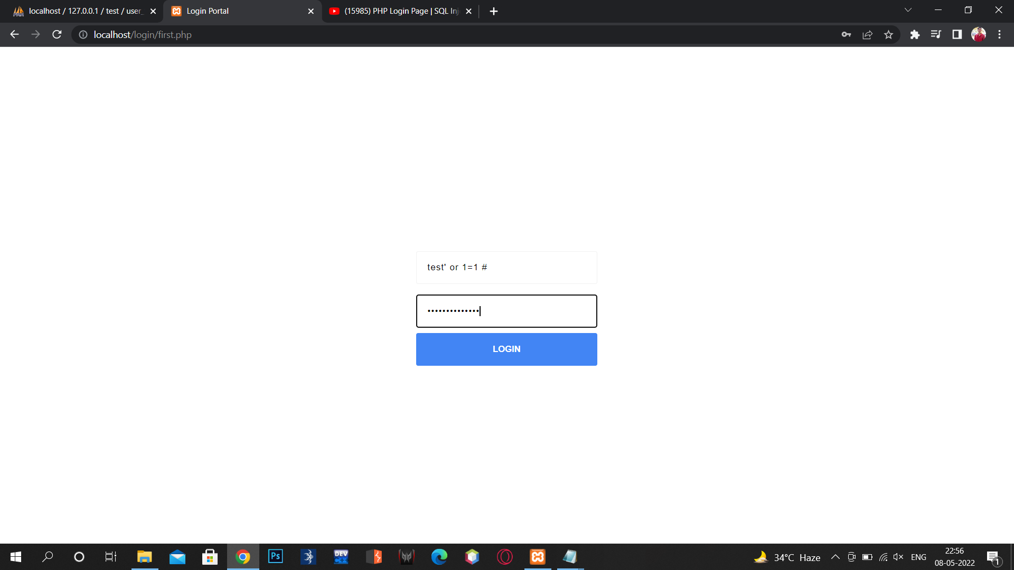
SQL Injection Attack
14

Slide 15
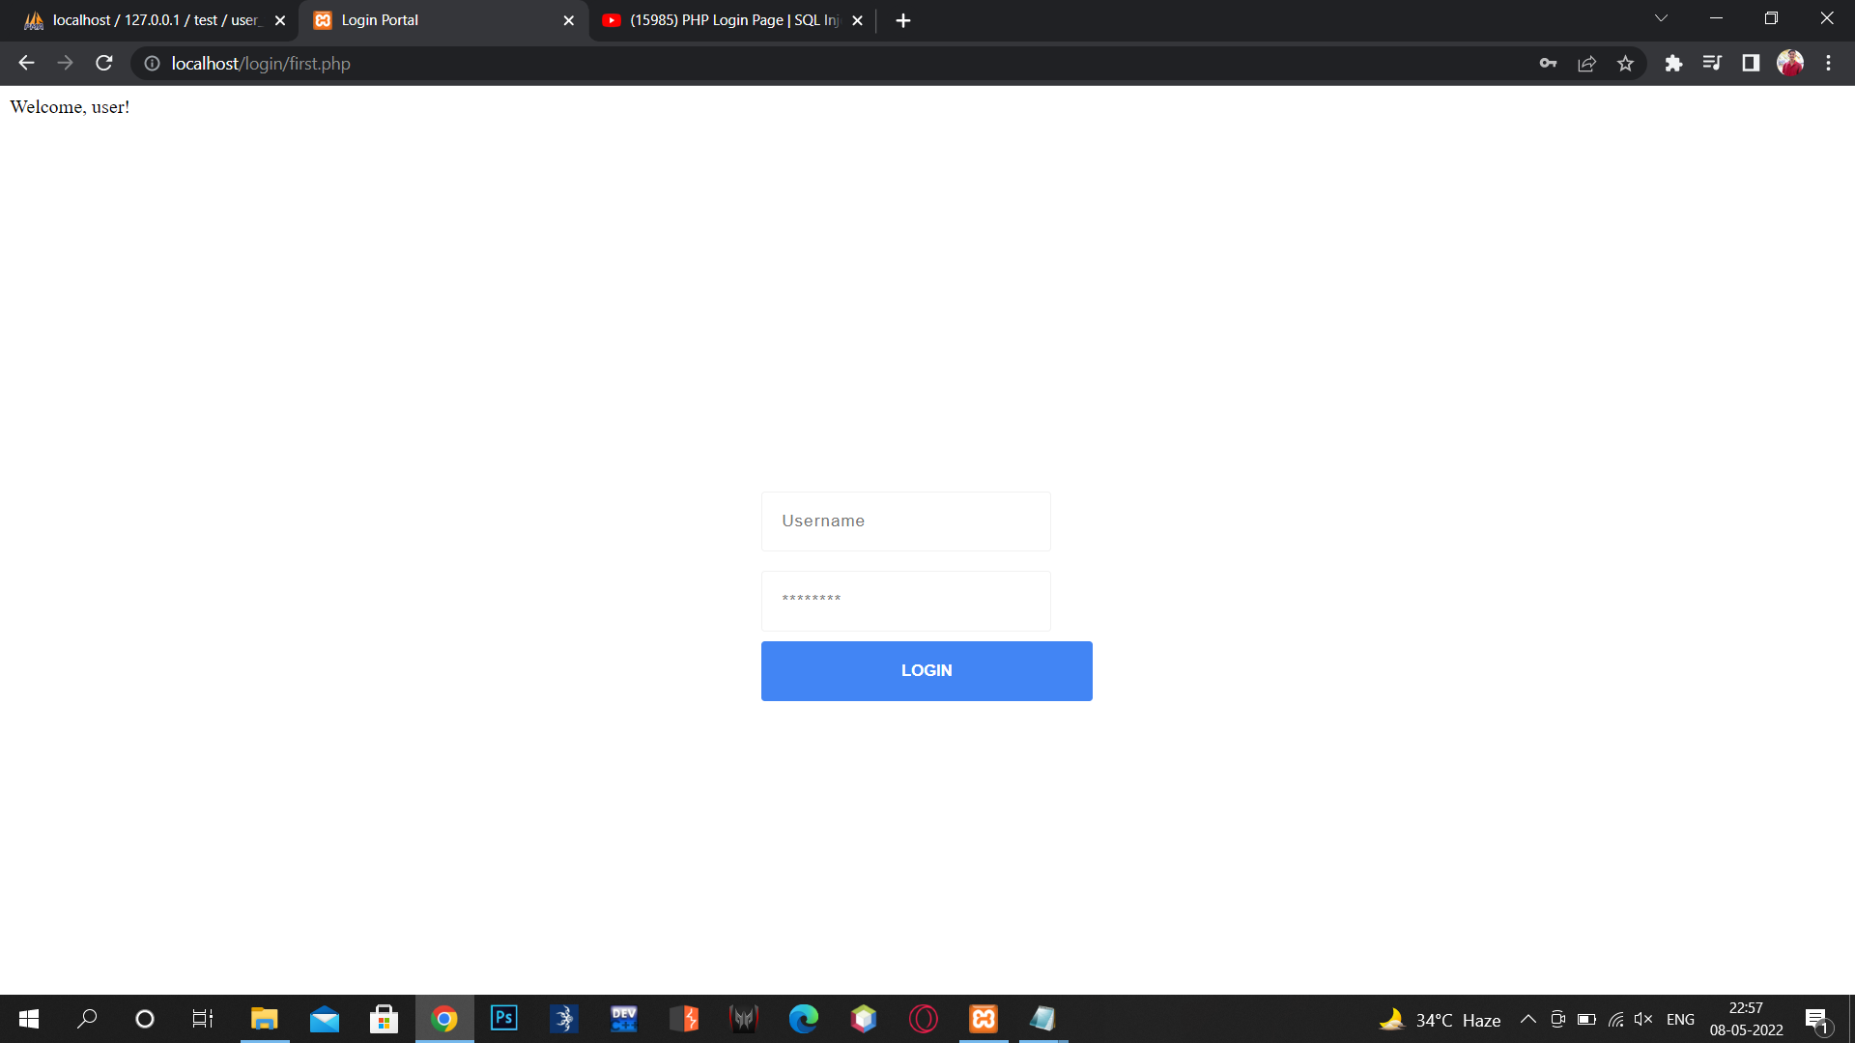
SQL Injection Attack
15

Slide 16
Future Scope
It can be further extended to detect and prevent attacks like DDoS, buffer overflow, password cracking etc.
Also information gathering attacks such as port scanning , mirroring , source code disclosure etc can be detected and prevented.
16

Slide 17
ADVANTAGES
Proxy server can detect and prevent both SQL injection.
Policies can be added easily.
Proxy server can be easily integrated with any type of web server (PHP, flask, django, asp).
17

Slide 18
THANK YOU
18

